Slide 1
Win Loss Analysis – Apr-Aug FY15
HiTech TEG

Slide 2
Overall Statistics
Analysis done on 101 Bids supported till end of Aug’14
Total Supported bid value was USD 248M

Slide 3
Summary – CoE Level
Microsoft CoE is supporting close to 50% of bids coming following by BIPM and Java CoE.
Average Bid Size for Big Data is high on account of a single large bid from Microsoft

Slide 4
Summary – Segment Level
SPS segment is accounting for close to 50% of bids and around 90% of supported big value.
Average Bid Size of bids is less than 1M for all segments apart from SPS (couple of bids from Microsoft)

Slide 5
Summary – Bid Status
WON 13% of Bids where participated. This however accounted for just 3% of supported bid value
9% of bids are in shortlisted stage accounting close to 29% of supported bid value
21% of Bids Supported where shelved accounting for 39% of supported bid value
17% of supported bid were lost contributing to 12% of supported Bid Value
Across segments and CoE Shelved bids are biggest contributor (~50%) to supported bids
Notes:
ISU level
WON Bid Value – 13% WON Bid Count – 17%
Loss Value – 19% Count – 6%
Shelved Value – 21% count – 29%

Slide 6
Summary – TEG Support
CPE
Largest Bids from HP (USD 57M with TEG share of 27%)
Rest of the bids average around 300k (12 bids)
Semi
Intel bids contributed to 44% of TEG supported bid value
Average bid value supported by TEG ~USD 0.5M
TEG is supporting/influencing around 53% of Bid value coming our way
Share of TEG is lowest in Bids belonging to CPE Segment (~26%)
SPS
~43% of bids from MS Account with 93% wallet share
PWC : 5 bids worth USD 25M with TEG share of USD 0.2M
Excluding MS and PWC bids, average Bid size is less than 1M

Slide 7
Win – Loss Details
WIN % : 27%(we are winning nearly one third of bids where decision has been taken)
Shelved % : ~41% of bids where TEG is participating are getting shelved
Going by this of the 40 bids either being worked upon or decision is pending we might win 10, loose 12 and 16 will get shelved
We are winning 4% of bid value where decision is taken
75% of value TEG bids for, is getting shelved
Going by this we will
Win bids worth ~4M
Loose bids worth 21M
Bids worth 77M will get shelved
Notes:
47

Slide 8
Bid Distribution across Bid Value
More than 70% of bids are less then 1M in value (TEG Supported) and contribute 5% of wallet share
9% of bids are for more than 5M in value and contribute 78% of wallet share
We are winning bids that are less than 1M in value
Losing more bids in >5M category as compared to <1M category
While we are submitting more or less equivalent number of <1 and >5M bids, when it comes to winning >5M is lagging behind

Slide 9
Bid Ageing
Semiconductor segment is quickest in taking decision (bids coming to TEG are mostly with full ownership)
CPE Segment takes maximum time to respond back (where we have around 13% wallet share) – around 4 months
SPS Segment (contributing maximum number of bids and close to 60% wallet share) is taking roughly around 3 months to take decision
Responding to bids from Semiconductor segment is least effort consuming (one outlier (One lost bid Global Foundries contributing to high value)
Responses to bids from CPE Segment takes maximum effort

Slide 10
Key findings
TEG share is 39% of Bid Value coming our way (USD 248M out of USD 621M)
TEG is involved in supporting 13% of bids addressed by ISU (CPE – 13%, Semi – 8% and SPS – 21%)
We are winning 13% of bids supported (~4% of bid value that we bid for) – (23% bids and 13% value at overall ISU level)
75% of bid value that TEG bids for is getting shelved (41% at ISU level)
70% of bids supported by TEG have value less than USD 1M contributing to 5% wallet share
Average Bid value at TEG level is close average Bid value at ISU level
SPS segment contribute maximum to TEG supported bids and maximum wallet share
Microsoft CoE is front ending majority of bids
Bids from CPE segment are taking most time in decision making
The account that contribute most number of bids or contributing towards bigger bids (Microsoft, PWC, HP and Intel), we are not winning anything
Our biggest wins have been Cannon (USD 1.89M out of USD 16.5M) and Equinix (USD 1.25M out of USD 2.5m)

Slide 11
Increase effectiveness
Qualify bids as they are received
Have a value less then 1M
Involve MS Tech stuff
Are from Semi or SPS segment
Have value averaging to 1M
Have clear defined requirement
TEG has major stake (% share >75%)
Some observed characteristics
High value (typically >3M)
Generic requirements mainly asking for approach in areas like managed services, capabilities etc.
Low TEG share
High Chance of getting shelved
High Chance of Winning
High Chance losing
What about Large Deals (>10M Opportunities)
If Are mainly vendor consolidation, Level 3 support, ADM services kind of exercise
If Overall TEG Share is less than 25%
Effort will be better spent on other activities

Slide 12
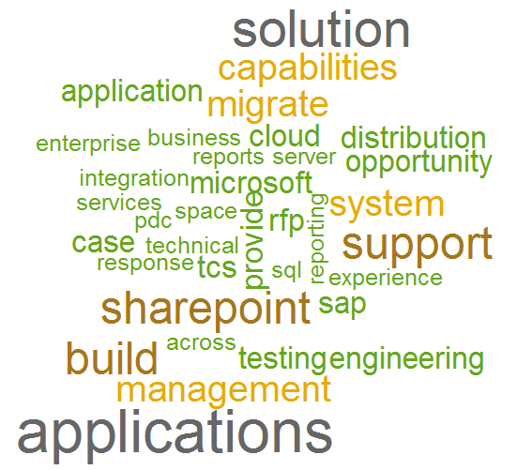
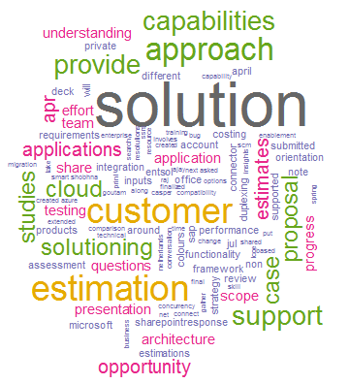
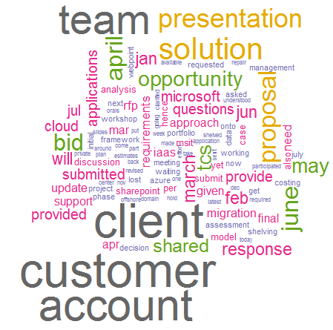
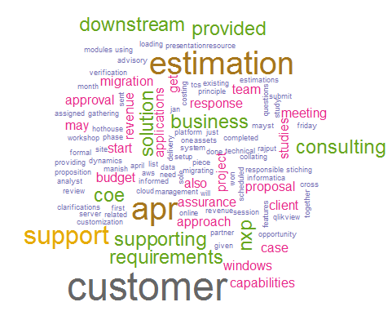
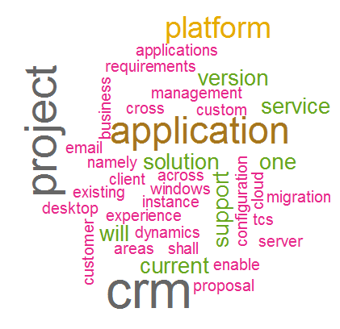
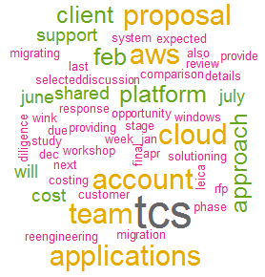
Understand business and Talk Business
Opportunity Description
HTSC Contribution
Comments
Loss
Win

Slide 14
Appendix A : Bid Status – Segment wise
Across Segments – shelved bids are contributing most towards supported bid value

Slide 15
Appendix B : Bid Status –CoE Wise

Slide 16
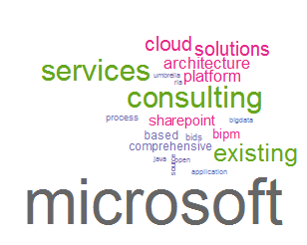
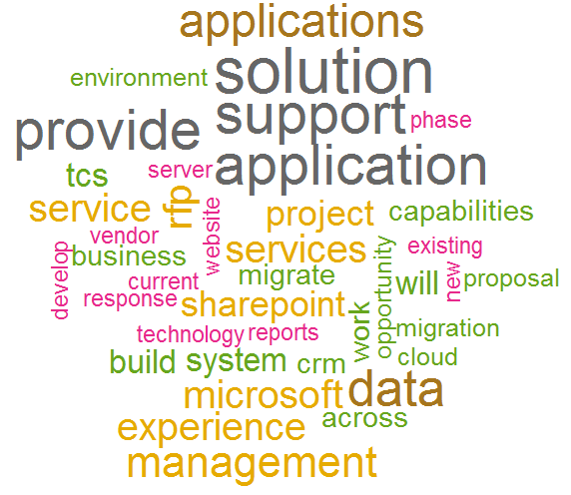
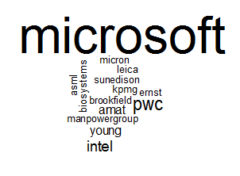
Opportunity Description
Proposed Offering
Customer

Slide 17
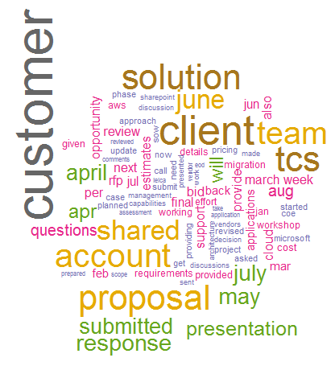
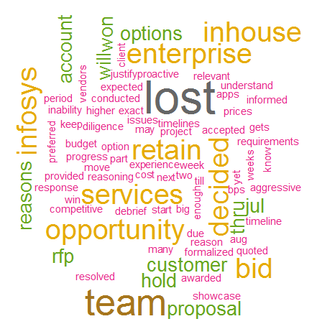
Comments
Win Loss Comments

Slide 18
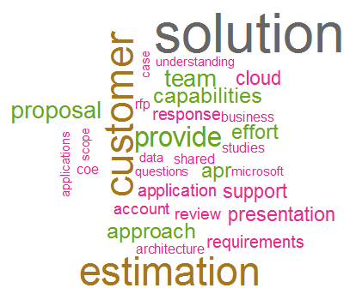
HTSC Contribution

